Slide 1



Infosys Springboard Internship
Group – 1 Batch – 11
Project Title
Food Trends: Understanding Customer Preferences
Domain: Data Visualization
Mentor:
Presented by:
Ms. Nityasree
Abhinit Kumar
Team - A

Slide 2
OBJECTIVES & PROJECT DESCRIPTION
Objectives : To analyze customer food ordering behavior using data visualization and business intelligence techniques, with the aim of identifying meaningful patterns and insights that help food businesses improve customer satisfaction, operational efficiency, and decision-making.
Project Description : This project analyzes customer food ordering data to understand preferences, ordering habits, and service expectations. Using interactive Power BI dashboards, the analysis highlights customer demographics, cuisine choices, ordering platforms, delivery experience, and the impact of promotions and time on customer decisions. The insights generated support food businesses in making data-driven strategies to enhance quality, pricing, and overall customer experience.

Slide 3
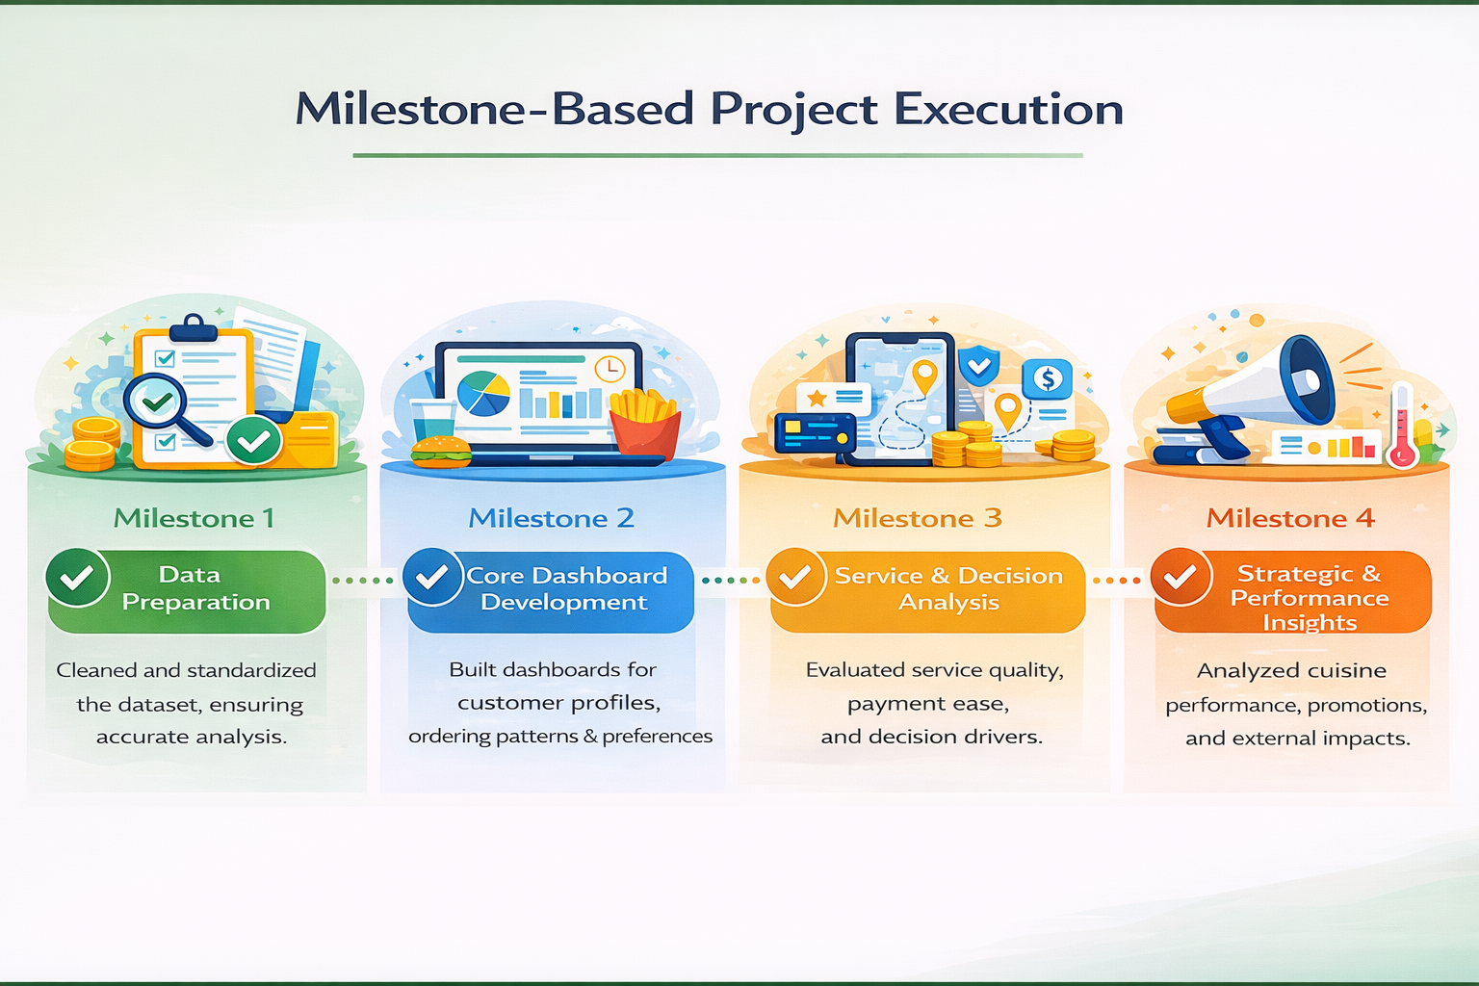

Slide 4
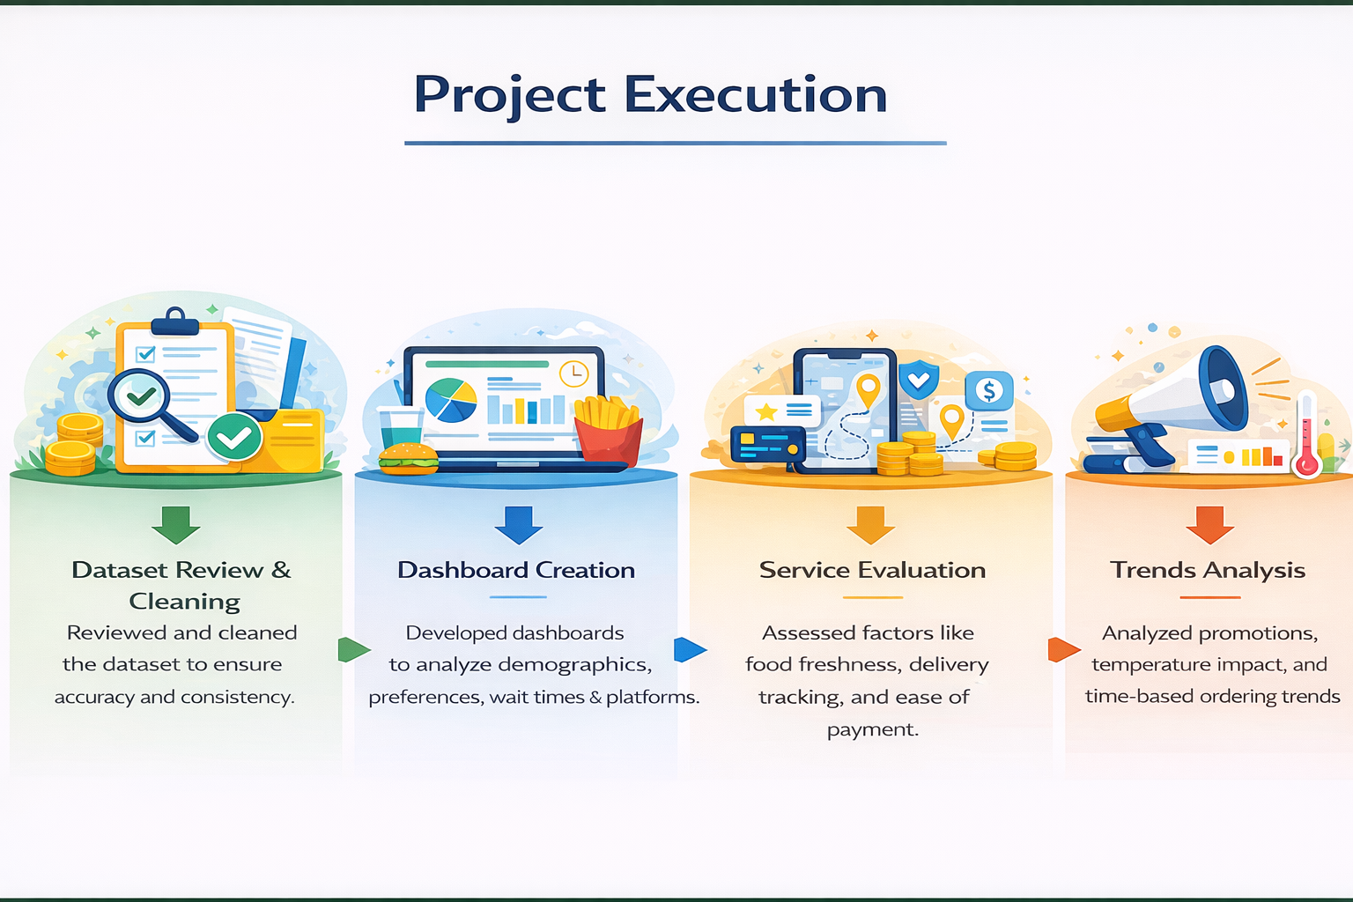

Slide 5
DATASET OVERVIEW
• Source : Survey-based Food Ordering Dataset (Excel / CSV)
• Volume : 387 total customer records covering food ordering preferences and behavior.
• Dataset Structure : Approximately 35 columns capturing customer, restaurant, order, service, and external factors.
Key Parameters:
• Customer demographics (Age, Gender, Marital Status, Family Size)
• Restaurant, cuisine, and food type (Veg / Non-Veg) details
• Order platform, payment mode, order time, and waiting time
• Service quality factors such as taste, freshness, tracking, and ease of payment
• Customer decision influencers including ratings, offers, health concern, and temperature
• Location and platform-related attributes

Slide 6
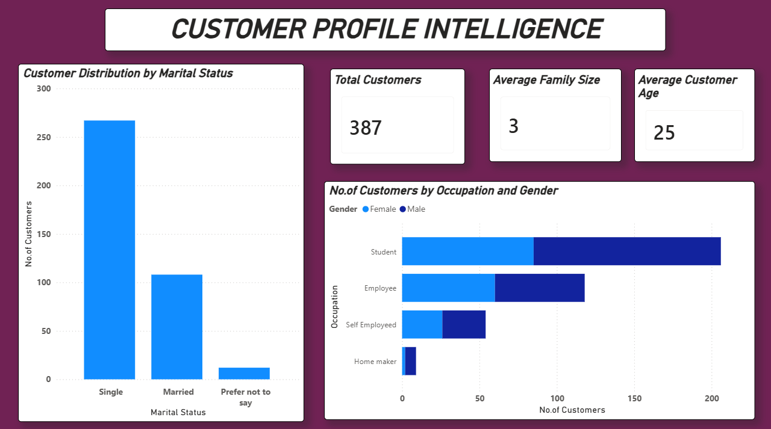
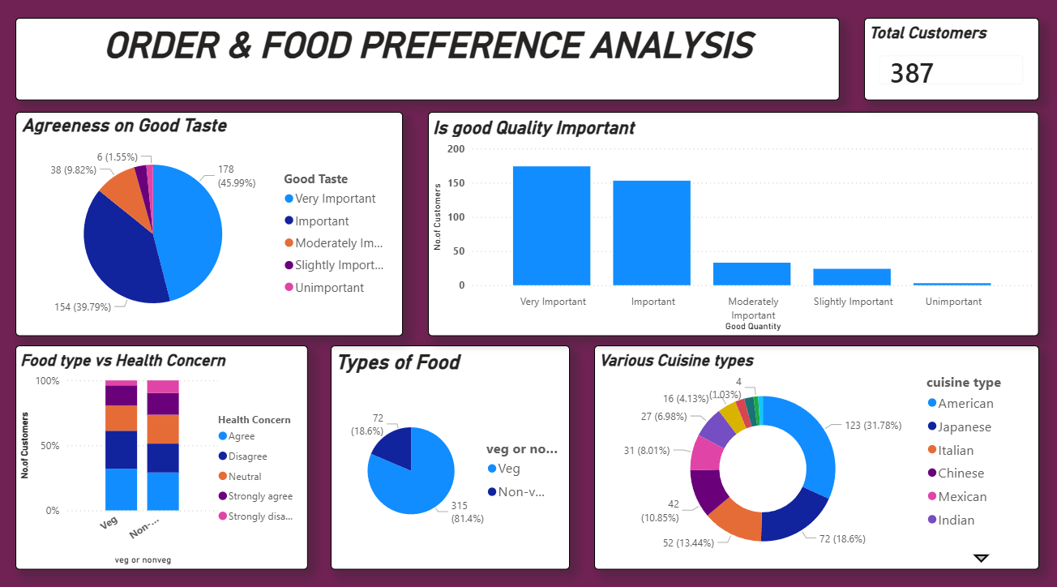
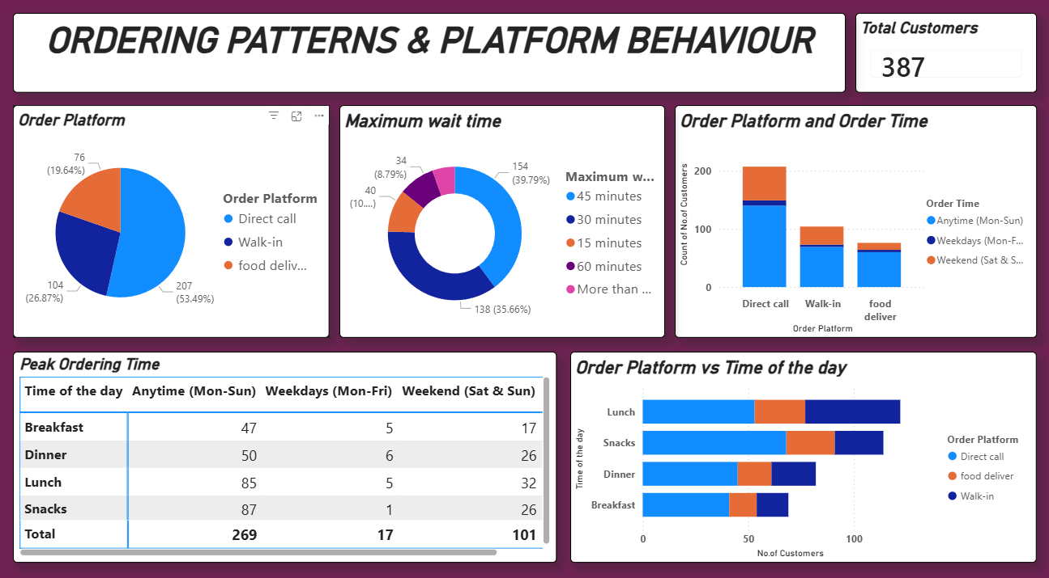
Dashboard images

Slide 7
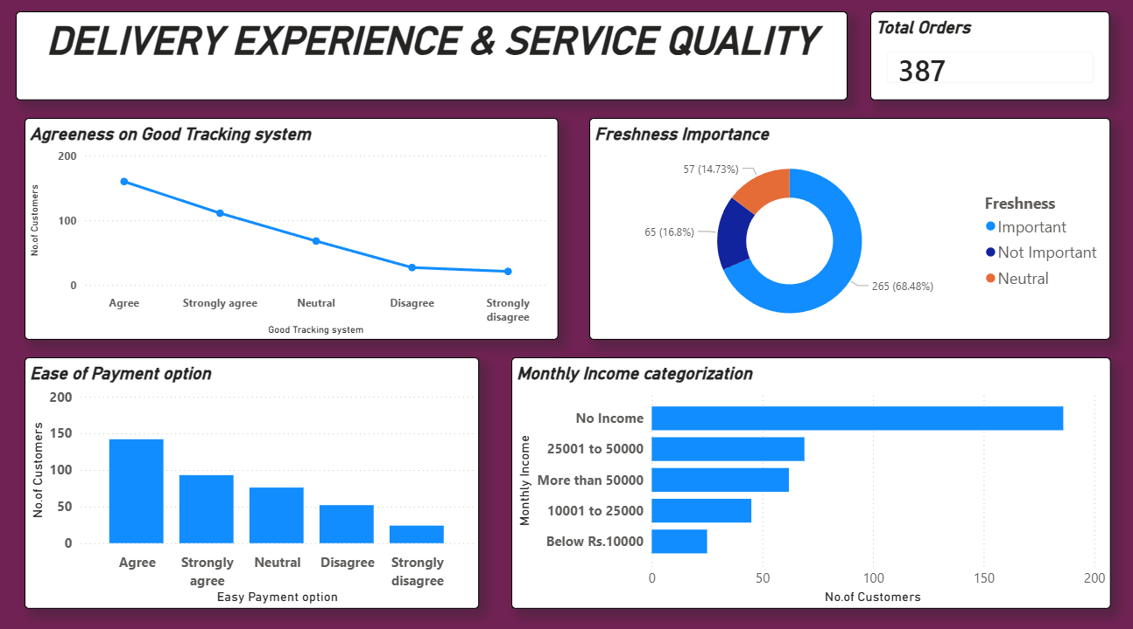
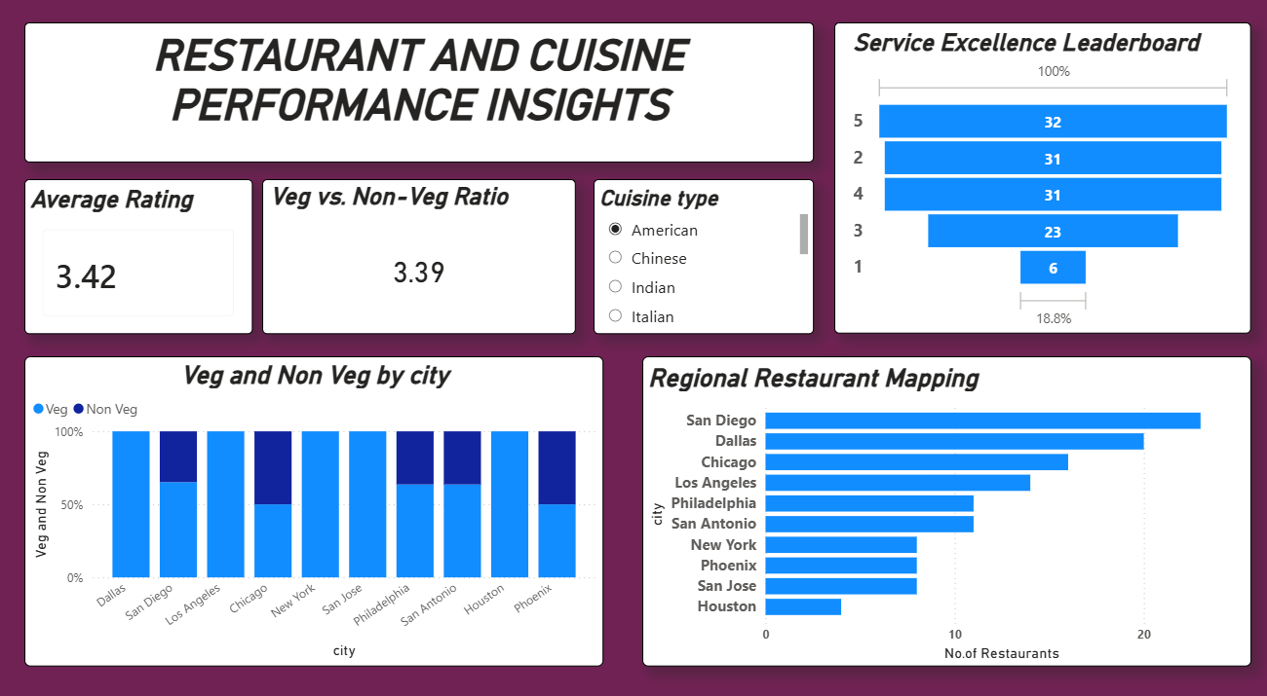
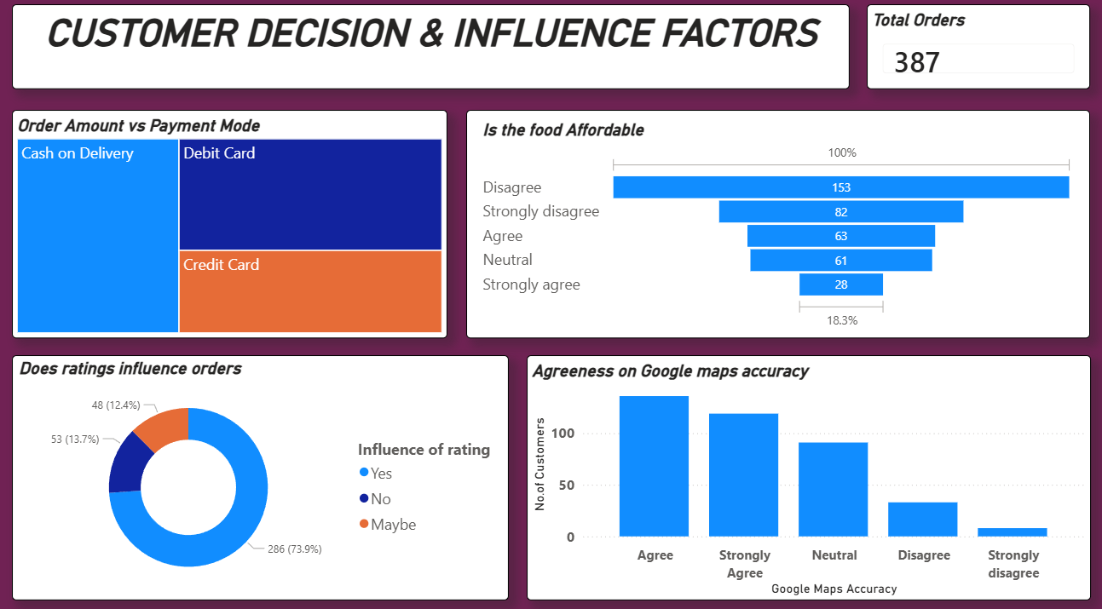
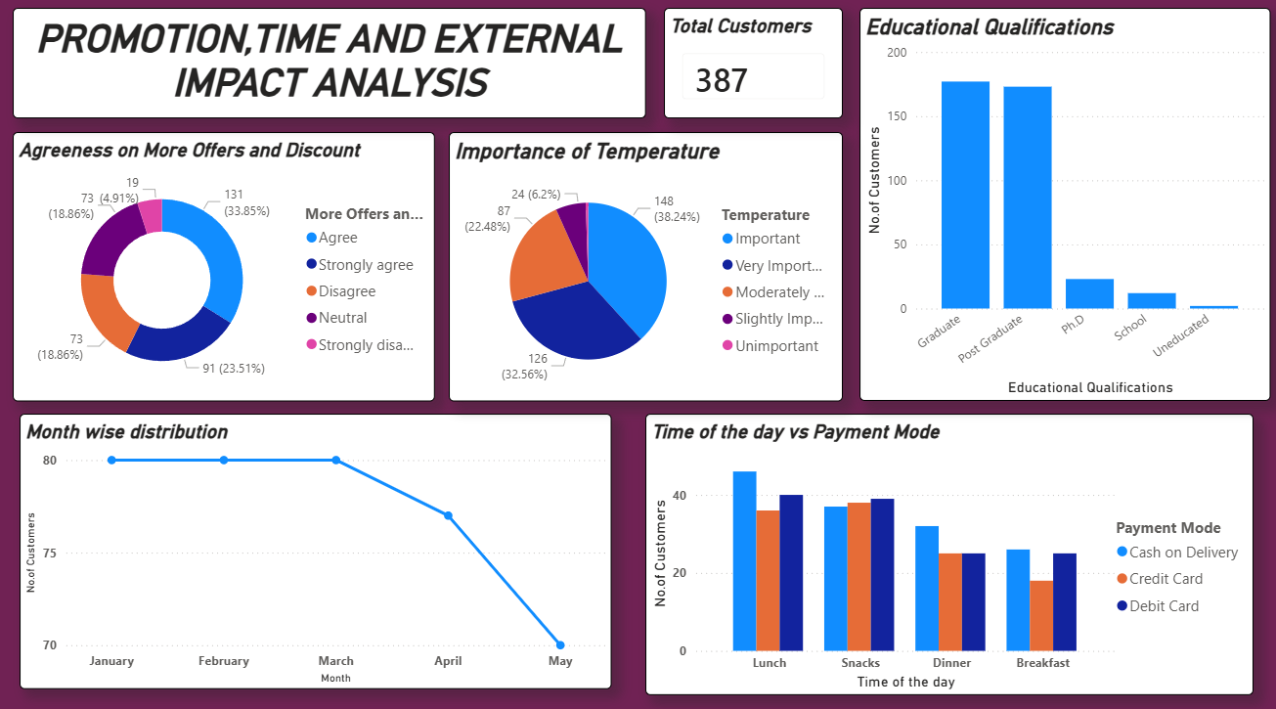

Slide 8
CHALLENGES FACED & RESOLUTIONS
Challenge 1 : Complex Dataset Structure
The dataset included multiple customer, order, and survey-based fields, making analysis complex.
Resolution : Data was grouped into logical categories to simplify analysis and visualization.
Challenge 2 : Inconsistent Data Values
Fields like Veg/Non-Veg and rating levels had inconsistent and missing values.
Resolution : Data cleaning and standardization were applied to ensure accuracy.
Challenge 3 : Dashboard Consistency
Maintaining a uniform layout and KPIs across 7 dashboards was challenging.
Resolution : A consistent theme and milestone-wise development approach were followed.

Slide 9
KEY INSIGHTS & FUTURE ENHANCEMENTS
Key Insights
Taste, food quality, and freshness are the strongest drivers of customer satisfaction.
Young customers and students form the largest customer segment.
Vegetarian food is preferred by the majority of customers.
Direct call ordering is still widely used along with online platforms.
Ratings, discounts, and location accuracy significantly influence ordering decisions.
Future Enhancements
Integration of real-time order and customer data.
Advanced customer segmentation using behavioral patterns.
Predictive analytics for demand forecasting and peak-time planning.
Integration with live food delivery platforms for dynamic insights.

Slide 10
CONCLUSION
The dashboards effectively analyze customer demographics, food preferences, and ordering behavior, providing meaningful business insights.
Taste, food quality, freshness, and service experience are the key factors influencing customer satisfaction and ordering decisions.
These insights help businesses optimize operations, improve customer experience, and make data-driven decisions for future growth.
Overall, this project demonstrates how data visualization using Power BI helps businesses make data-driven decisions, improve customer satisfaction, optimize operations, and plan effective marketing strategies.

Slide 11
ACKNOWLEDGEMENT & REFERENCES
We would like to express our heartfelt gratitude to the Infosys Springboard Team for organizing this valuable internship opportunity and providing a strong learning platform.
We sincerely thank our Mentor for her continuous support, guidance, and constructive feedback throughout the project.
We are also grateful to our teammates for their collaboration, encouragement, and valuable insights during the project work.
This internship has been a significant step in our professional growth and technical journey, helping us strengthen our skills in data analysis and visualization.
References
Microsoft Power BI Documentation
Infosys Springboard Virtual Internship course materials

Slide 12
THANK YOU

